Slide 1
PHYS 304: Lecture 14 (Intro to) Quantum Mechanics
Sept-Dec 2021 Edition
Jeff Young
brimacombe Rm 278, young@phas.ubc.ca

Slide 2
Mid-Course Survey
< 35% response rate, so very difficult to make firm conclusions
Does seem to be consensus that using blackboard is preferred over mostly .pptx slides, so will continue with that, where it makes sense.
Split roughly 50/50 on value of TPS exercises. Likely based on whether or not one does the pre-reading. TPS exercises designed to work well if pre-reading has been seriously reviewed. I will keep some, but likely less than at beginning of course.
A fair number of people would like more iClicker questions. We will do that in tutorials and lectures, again, where it makes sense.
Thanks to those who filled it out!

Slide 3

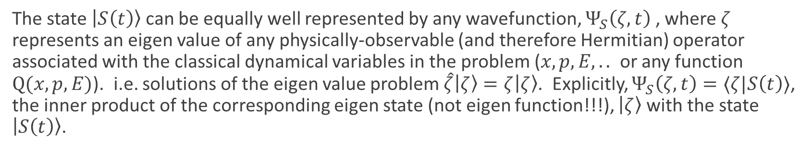

Review of key points from last lecture
A general quantum mechanical state, represented by the ket $\left|S\left(t\right)\right\rangle$, contains all the information it is possible to know about the dynamical evolution of a point particle moving in some time-independent potential.
The wavefunction that we have so far associated with the state, $Ψ_{S}\left(x,t\right)$ - where I have added a subscript S to acknowledge the fact that the abstract state $\left|S\left(t\right)\right\rangle$ is in a sense “more fundamental” than the wavefunction used to represent it - is one of many possible wavefunctions that can be associated with the state $\left|S\left(t\right)\right\rangle$.
The state $\left|S\left(t\right)\right\rangle$ can be equally well represented by any wavefunction, $Ψ_{S}\left(ζ,t\right)$ , where $ζ$ represents an eigen value of any physically-observable (and therefore Hermitian) operator associated with the classical dynamical variables in the problem ($x,p,E,..$ or any function $Q(x,p,E)$). i.e. solutions of the eigen value problem $\hat{ζ}\left|ζ\right\rangle =ζ\left|ζ\right\rangle$. Explicitly, $Ψ_{S}\left(ζ,t\right)=⟨ζ|S\left(t\right)⟩$, the inner product of the corresponding eigen state (not eigen function!!!), $\left|ζ\right\rangle$with the state $\left|S\left(t\right)\right\rangle$.

Slide 4
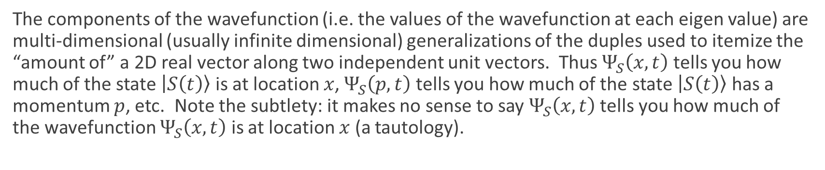

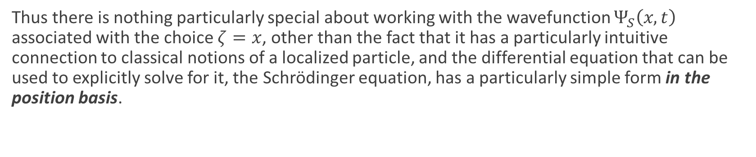
Review of key points from last lecture
The components of the wavefunction (i.e. the values of the wavefunction at each eigen value) are multi-dimensional (usually infinite dimensional) generalizations of the duples used to itemize the “amount of” a 2D real vector along two independent unit vectors. Thus $Ψ_{S}\left(x,t\right)$ tells you how much of the state $\left|S\left(t\right)\right\rangle$ is at location $x$, $Ψ_{S}\left(p,t\right)$ tells you how much of the state $\left|S\left(t\right)\right\rangle$ has a momentum $p$, etc. Note the subtlety: it makes no sense to say $Ψ_{S}\left(x,t\right)$ tells you how much of the wavefunction $Ψ_{S}\left(x,t\right)$ is at location $x$ (a tautology).
Thus there is nothing particularly special about working with the wavefunction $Ψ_{S}\left(x,t\right)$ associated with the choice $ζ=x$, other than the fact that it has a particularly intuitive connection to classical notions of a localized particle, and the differential equation that can be used to explicitly solve for it, the Schrödinger equation, has a particularly simple form in the position basis.
We showed that the eigen value equation for the position operator, $\hat{x}\left|ζ\right\rangle =ζ\left|ζ\right\rangle$, (note this is defined using states, not wavefunctions!!!) that becomes $x′ f\left(x′\right)=ζf\left(x′\right)$ in the position basis, has eigen functions $f\left(x^{′}\right)=δ(x−x′)$ for a continuum of eigen values $ζ=x$.

Slide 5
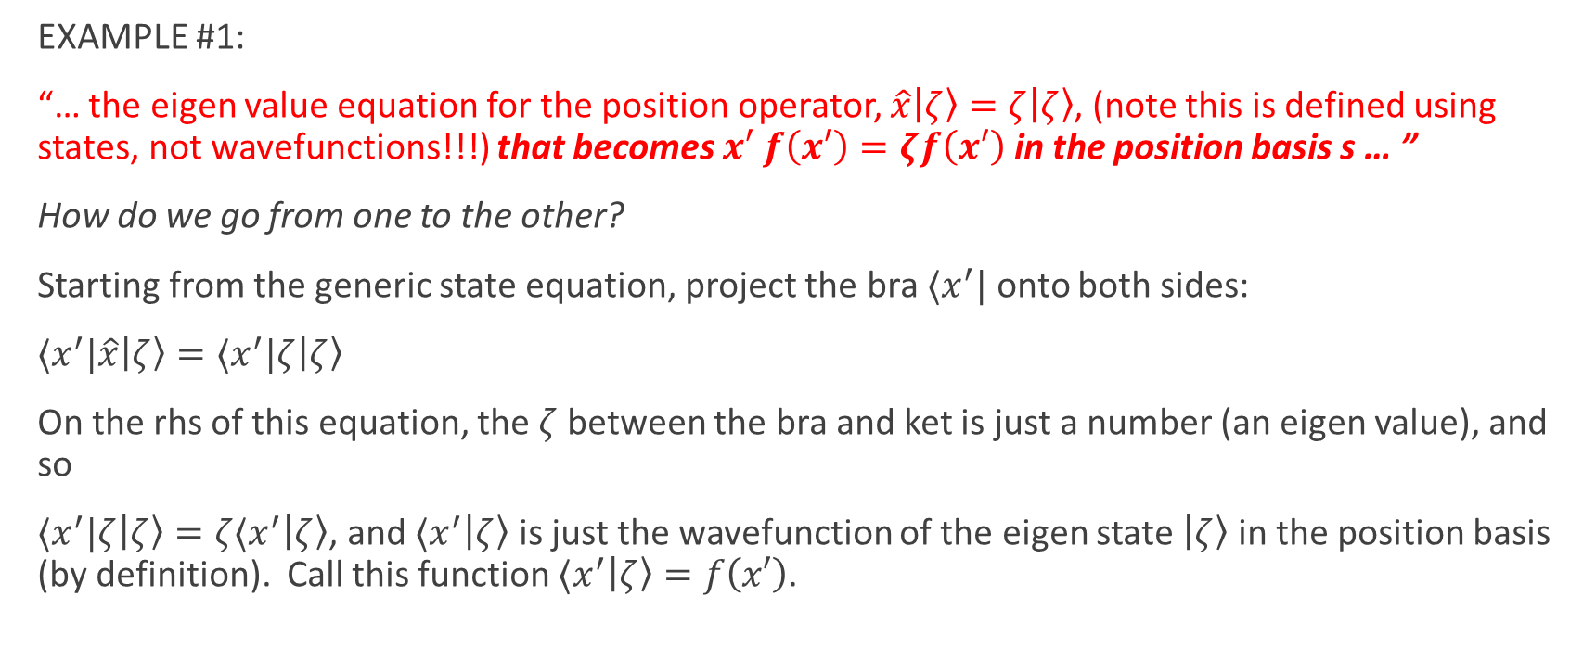
Today: More experience with states, wavefunctions, and matrix representations
EXAMPLE #1:
“… the eigen value equation for the position operator, $\hat{x}\left|ζ\right\rangle =ζ\left|ζ\right\rangle$, (note this is defined using states, not wavefunctions!!!) that becomes $x′ f\left(x′\right)=ζf\left(x′\right)$ in the position basis s … ”
How do we go from one to the other?
Starting from the generic state equation, project the bra $⟨x^{′}|$ onto both sides:
$⟨x^{′}|\hat{x}\left|ζ\right\rangle =⟨x^{′}|ζ\left|ζ\right\rangle$
On the rhs of this equation, the $ζ$ between the bra and ket is just a number (an eigen value), and so
$⟨x^{′}|ζ\left|ζ\right\rangle =ζ⟨x^{′}\left|ζ\right\rangle$, and $⟨x^{′}\left|ζ\right\rangle$ is just the wavefunction of the eigen state $\left|ζ\right\rangle$ in the position basis (by definition). Call this function $⟨x^{′}\left|ζ\right\rangle =f\left(x′\right)$.

Slide 6


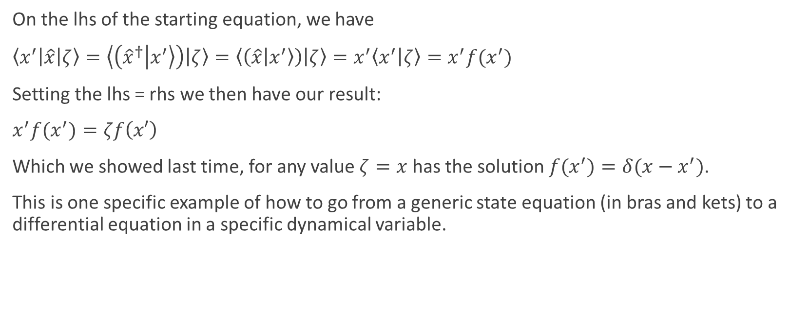
States vs wavefunctions
On the lhs of the starting equation, we have
$\left\langle x^{′}\left|\hat{x}\right|ζ\right\rangle =\left\langle \left({\hat{x}}^{†} | x^{′}\right\rangle \right)\left|ζ\right\rangle =\left\langle \left(\hat{x} | x^{′}\right\rangle \right)\left|ζ\right\rangle =x^{′}\left\langle x^{′} | ζ\right\rangle =x^{′}f(x^{′})$
Setting the lhs = rhs we then have our result:
$x^{′}f(x^{′})=ζf\left(x′\right)$
Which we showed last time, for any value $ζ=x$ has the solution $f(x^{′})=δ(x−x^{′})$.
This is one specific example of how to go from a generic state equation (in bras and kets) to a differential equation in a specific dynamical variable.

Slide 7
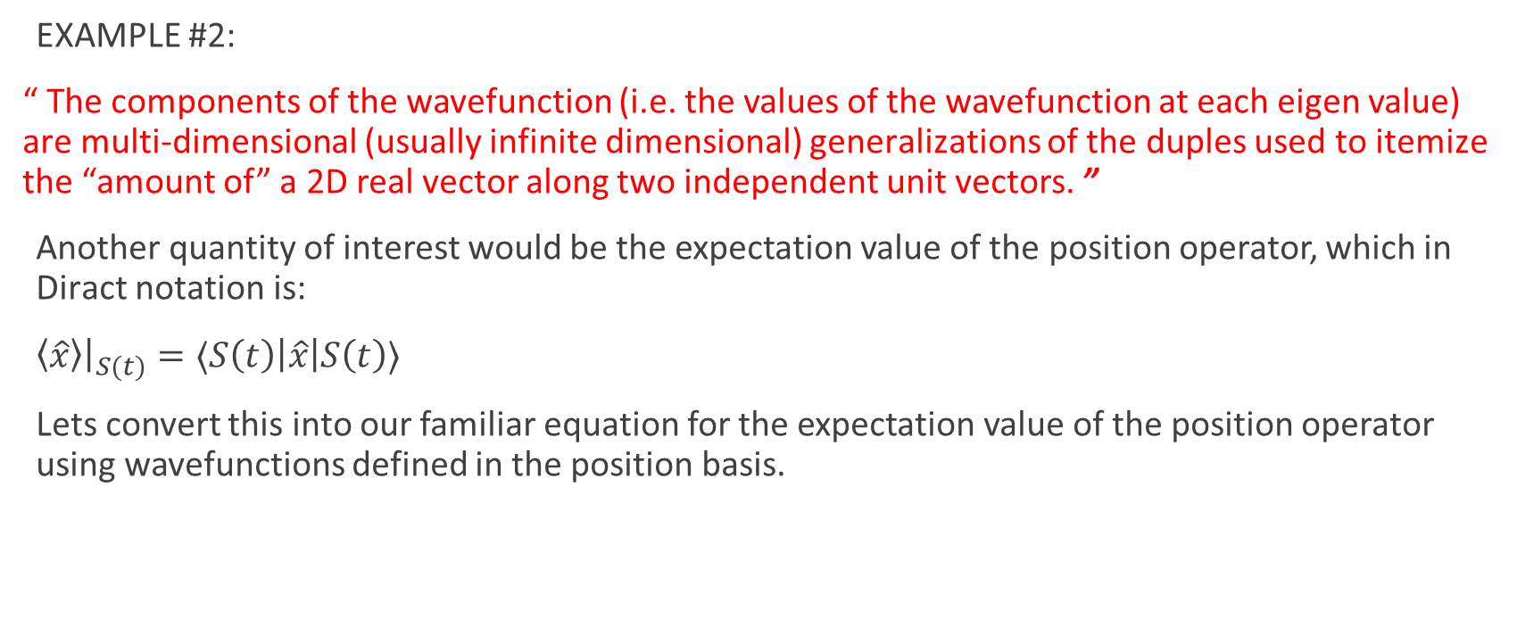
States vs wavefunctions
EXAMPLE #2:
“ The components of the wavefunction (i.e. the values of the wavefunction at each eigen value) are multi-dimensional (usually infinite dimensional) generalizations of the duples used to itemize the “amount of” a 2D real vector along two independent unit vectors. ”
Another quantity of interest would be the expectation value of the position operator, which in Diract notation is:
$\left\langle \hat{x}\right\rangle {\left.​\right|}_{S(t)}=⟨S\left(t\right)\left|\hat{x}\right|S\left(t\right)⟩$
Lets convert this into our familiar equation for the expectation value of the position operator using wavefunctions defined in the position basis.

Slide 8
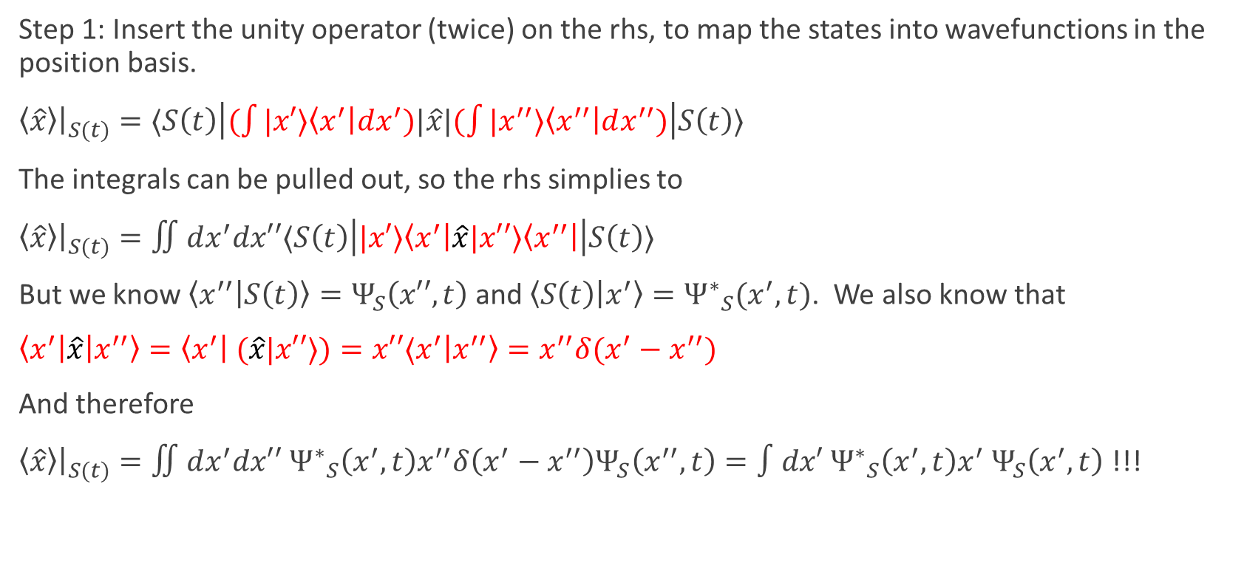
States vs wavefunctions
Step 1: Insert the unity operator (twice) on the rhs, to map the states into wavefunctions in the position basis.
$\left\langle \hat{x}\right\rangle {\left.​\right|}_{S(t)}=⟨S\left(t\right)\left|(\int{|x′}⟩\left\langle x^{′}\right|dx^{′})|\hat{x}|(\int{|x^{′′}}⟩\left\langle x^{′′}\right|dx^{′′})\right|S\left(t\right)⟩$
The integrals can be pulled out, so the rhs simplies to
$\left\langle \hat{x}\right\rangle {\left.​\right|}_{S(t)}=∬dx^{′}dx′′⟨S\left(t\right)\left||x′⟩\left\langle x^{′}\right|\hat{x}|x′′⟩\left\langle x^{′′}\right|\right|S\left(t\right)⟩$
But we know $\left\langle x^{′′} | S\left(t\right)\right\rangle =Ψ_{S}\left(x′′,t\right)$ and $\left\langle S\left(t\right) | x^{′}\right\rangle ={Ψ^{∗}}_{S}(x^{′},t)$. We also know that
$\left\langle x^{′}\right|\hat{x}\left|x^{′′}\right\rangle =\left\langle x^{′}\right| (\hat{x}|x′′⟩)=x′′⟨x^{′}\left|x^{′′}\right\rangle =x^{′′}δ(x^{′}−x^{′′})$
And therefore
$\left\langle \hat{x}\right\rangle {\left.​\right|}_{S(t)}=∬dx^{′}dx′′$ ${Ψ^{∗}}_{S}\left(x^{′},t\right)x^{′′}δ\left(x^{′}−x^{′′}\right)Ψ_{S}\left(x^{′′},t\right)=∫dx′{{ Ψ}^{∗}}_{S}\left(x^{′},t\right)x^{′}{ Ψ}_{S}\left(x^{′},t\right)$ !!!

Slide 9
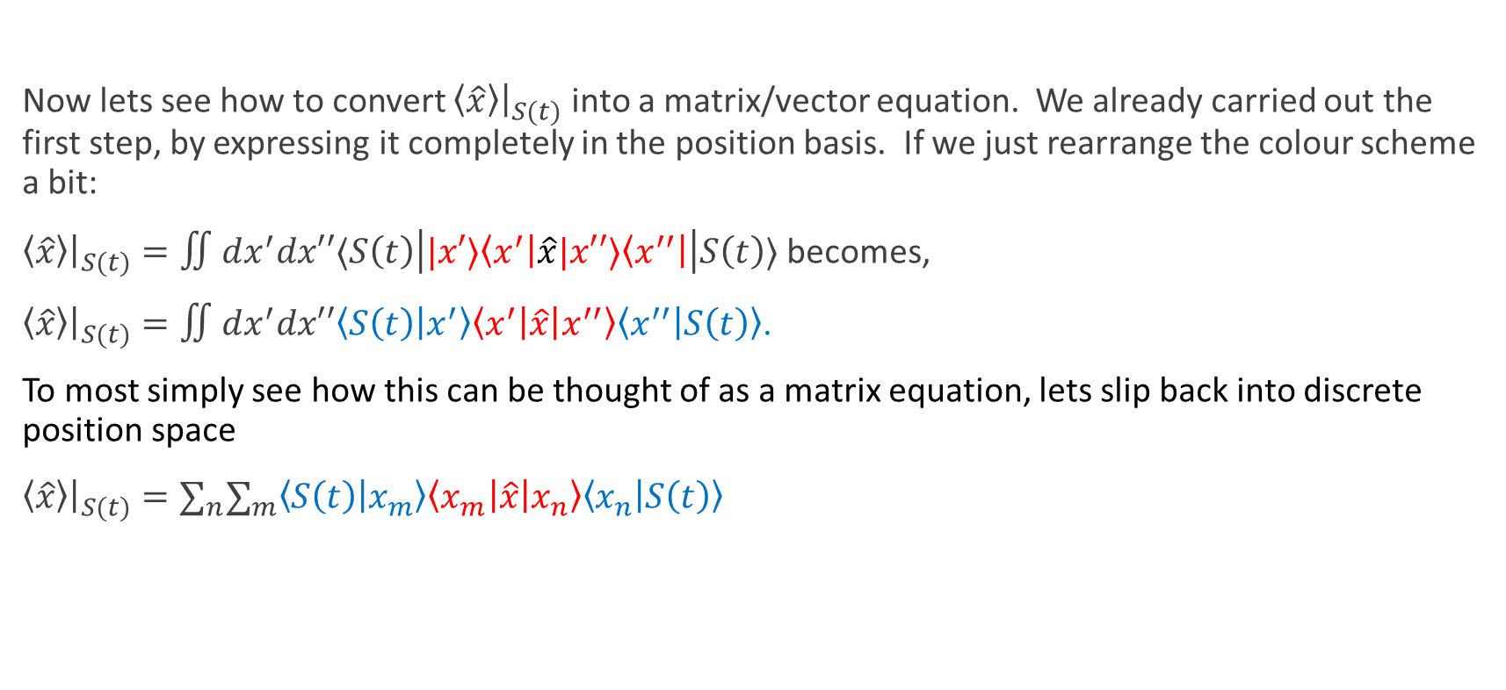
States, wavefunctions & matrix representations
Now lets see how to convert $\left\langle \hat{x}\right\rangle {\left.​\right|}_{S(t)}$ into a matrix/vector equation. We already carried out the first step, by expressing it completely in the position basis. If we just rearrange the colour scheme a bit:
$\left\langle \hat{x}\right\rangle {\left.​\right|}_{S(t)}=∬dx^{′}dx′′⟨S\left(t\right)\left||x′⟩\left\langle x^{′}\right|\hat{x}|x′′⟩\left\langle x^{′′}\right|\right|S\left(t\right)⟩$ becomes,
$\left\langle \hat{x}\right\rangle {\left.​\right|}_{S(t)}=∬dx^{′}dx′′\left\langle S\left(t\right) | x^{′}\right\rangle \left\langle x^{′}\right|\hat{x}\left|x^{′′}\right\rangle \left\langle x^{′′} | S\left(t\right)\right\rangle$.
To most simply see how this can be thought of as a matrix equation, lets slip back into discrete position space
$\left\langle \hat{x}\right\rangle {\left.​\right|}_{S(t)}=∑_{n}∑_{m}\left\langle S\left(t\right) | x_{m}\right\rangle \left\langle x_{m}\right|\hat{x}\left|x_{n}\right\rangle \left\langle x_{n} | S\left(t\right)\right\rangle$

Slide 10
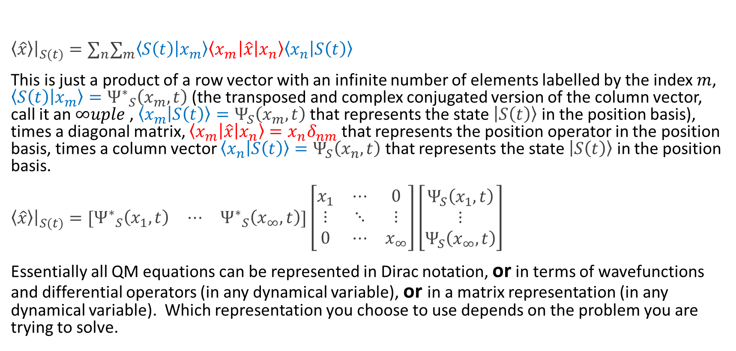
States, wavefunctions & matrix representations
$\left\langle \hat{x}\right\rangle {\left.​\right|}_{S(t)}=∑_{n}∑_{m}\left\langle S\left(t\right) | x_{m}\right\rangle \left\langle x_{m}\right|\hat{x}\left|x_{n}\right\rangle \left\langle x_{n} | S\left(t\right)\right\rangle$
This is just a product of a row vector with an infinite number of elements labelled by the index $m$, $\left\langle S\left(t\right) | x_{m}\right\rangle ={Ψ^{∗}}_{S}\left(x_{m},t\right)$(the transposed and complex conjugated version of the column vector, call it an $∞uple$ , $\left\langle x_{m} | S\left(t\right)\right\rangle =Ψ_{S}\left(x_{m},t\right)$ that represents the state $\left|S\left(t\right)\right\rangle$ in the position basis), times a diagonal matrix, $\left\langle x_{m}\right|\hat{x}\left|x_{n}\right\rangle =x_{n}δ_{nm}$ that represents the position operator in the position basis, times a column vector $\left\langle x_{n} | S\left(t\right)\right\rangle =Ψ_{S}\left(x_{n},t\right)$ that represents the state $\left|S\left(t\right)\right\rangle$ in the position basis.
$\left\langle \hat{x}\right\rangle {\left.​\right|}_{S(t)}=[\begin{matrix}{Ψ^{∗}}_{S}\left(x_{1},t\right) & ⋯ & {Ψ^{∗}}_{S}\left(x_{∞},t\right)\end{matrix}]\left[\begin{matrix}x_{1} & ⋯ & 0 \\ ⋮ & ⋱ & ⋮ \\ 0 & ⋯ & x_{∞}\end{matrix}\right]\left[\begin{matrix}Ψ_{S}\left(x_{1},t\right) \\ ⋮ \\ Ψ_{S}\left(x_{∞},t\right)\end{matrix}\right]$
Essentially all QM equations can be represented in Dirac notation, or in terms of wavefunctions and differential operators (in any dynamical variable), or in a matrix representation (in any dynamical variable). Which representation you choose to use depends on the problem you are trying to solve.
WARNING, THIS TREATMENT OF SPACE AS DISCRETIZED IS PURELY TO AID IN CONCEPTUAL UNDERSTANDING, AND TO INTRODUCE THE MATRIX/VECTOR REPRESENTATION
IT IS NOT RIGOROUSLY CORRECT WHEN THE ACTUAL OPERATORS HAVE A CONTINUOUS EIGEN SPECTRUM

Slide 11
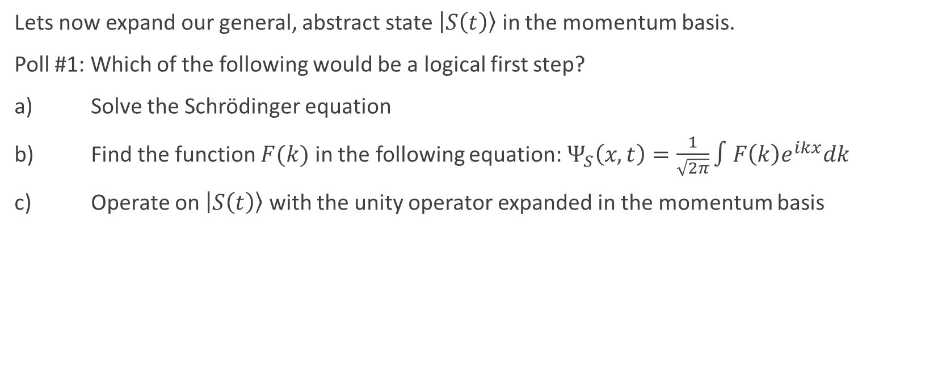
Lets go out of our comfort zone, and work instead with the momentum basis
Lets now expand our general, abstract state $\left|S\left(t\right)\right\rangle$ in the momentum basis.
Poll #1: Which of the following would be a logical first step?
a) Solve the Schrödinger equation
b) Find the function $F(k)$ in the following equation: $Ψ_{S}\left(x,t\right)=\frac{1}{\sqrt{2π}}∫F\left(k\right)e^{ikx}dk$
c) Operate on $\left|S\left(t\right)\right\rangle$ with the unity operator expanded in the momentum basis

Slide 12


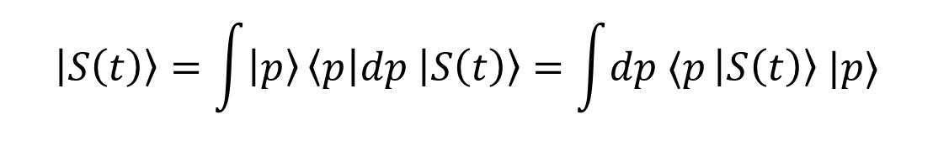
Expanding $\left|S\left(t\right)\right\rangle$ in the momentum basis
Lets now expand our general, abstract state $\left|S\left(t\right)\right\rangle$ in the momentum basis.
Poll #1: Which of the following would be a logical first step?
a) Solve the Schrödinger equation
b) Find the function $F(k)$ in the following equation: $Ψ_{S}\left(x,t\right)=\frac{1}{\sqrt{2π}}∫F\left(k\right)e^{ikx}dk$
c) Operate on $\left|S\left(t\right)\right\rangle$ with the unity operator expanded in the momentum basis
$$\left|S\left(t\right)\right\rangle =\int{\left|p\right\rangle }\left\langle p\right|dp \left|S\left(t\right)\right\rangle =\int{dp ⟨p}\left|S\left(t\right)\right\rangle |p⟩$$

Slide 13
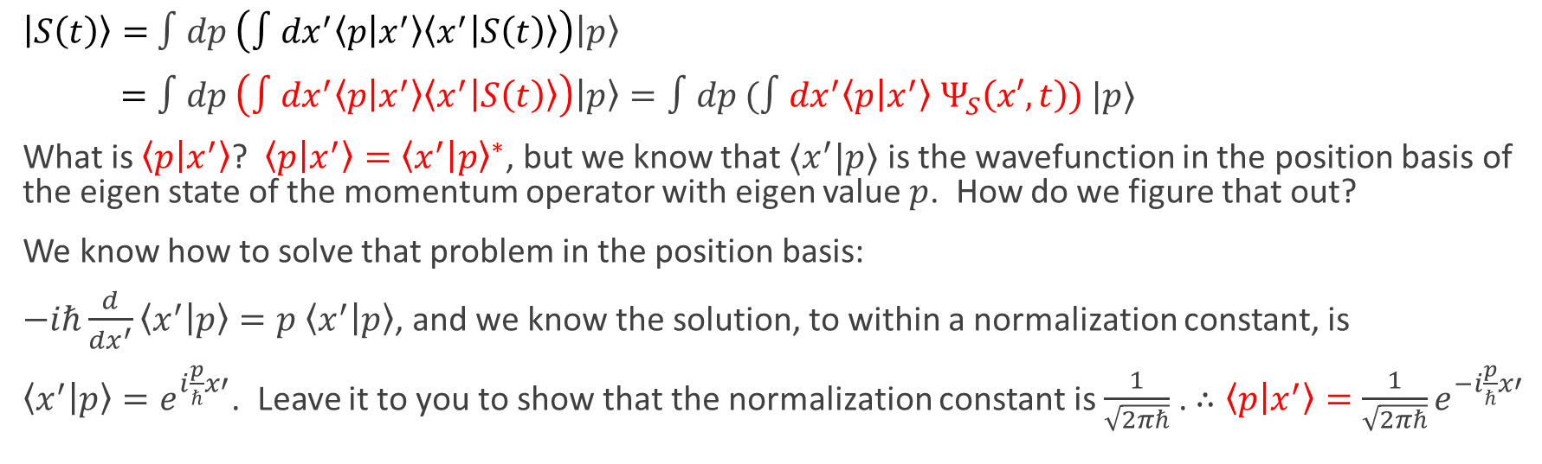
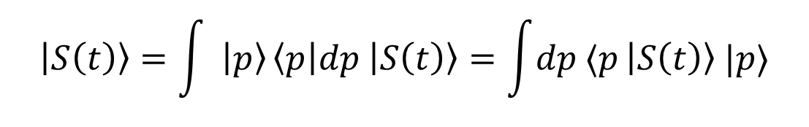
Expanding $\left|S\left(t\right)\right\rangle$ in the momentum basis
$$\left|S\left(t\right)\right\rangle =\int{ \left|p\right\rangle }\left\langle p\right|dp \left|S\left(t\right)\right\rangle =\int{dp ⟨p}\left|S\left(t\right)\right\rangle |p⟩$$
$\left|S\left(t\right)\right\rangle =$ $∫dp \left(∫dx^{′}\left\langle p | x^{′}\right\rangle \left\langle x^{′} | S\left(t\right)\right\rangle \right)\left|p\right\rangle$
$=∫dp \left(∫dx^{′}\left\langle p | x^{′}\right\rangle \left\langle x^{′} | S\left(t\right)\right\rangle \right)\left|p\right\rangle =∫dp (∫dx^{′}\left\langle p | x^{′}\right\rangle$ $Ψ_{S}\left(x′,t\right)) |p⟩$
What is $\left\langle p | x^{′}\right\rangle$? $\left\langle p | x^{′}\right\rangle ={\left\langle x^{′} | p\right\rangle }^{∗}$, but we know that $⟨x^{′}|p⟩$ is the wavefunction in the position basis of the eigen state of the momentum operator with eigen value $p$. How do we figure that out?
We know how to solve that problem in the position basis:
$−iℏ\frac{d}{dx^{′}}\left\langle x^{′} | p\right\rangle =p$ $\left\langle x^{′} | p\right\rangle$, and we know the solution, to within a normalization constant, is
$\left\langle x^{′} | p\right\rangle =e^{i\frac{p}{ℏ}x′}$. Leave it to you to show that the normalization constant is $\frac{1}{\sqrt{2πℏ}}$ . $∴\left\langle p | x^{′}\right\rangle =\frac{1}{\sqrt{2πℏ}}e^{−i\frac{p}{ℏ}x′}$

Slide 14

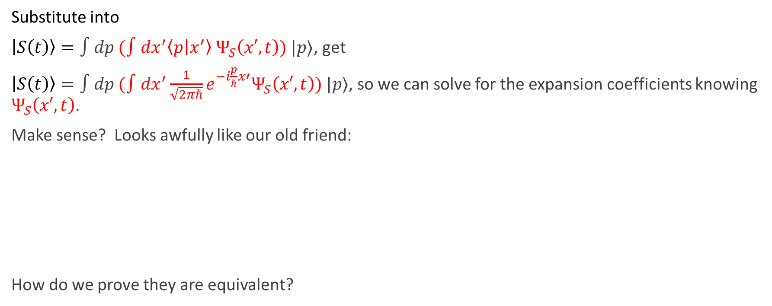

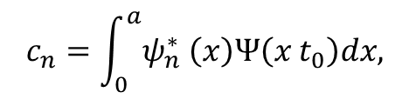

Expanding $\left|S\left(t\right)\right\rangle$ in the momentum basis
Substitute into
$\left|S\left(t\right)\right\rangle =∫dp (∫dx^{′}\left\langle p | x^{′}\right\rangle$ $Ψ_{S}\left(x′,t\right)) |p⟩$, get
$\left|S\left(t\right)\right\rangle =∫dp (∫dx^{′}\frac{1}{\sqrt{2πℏ}}e^{−i\frac{p}{ℏ}x′}Ψ_{S}\left(x′,t\right)) |p⟩$, so we can solve for the expansion coefficients knowing $Ψ_{S}\left(x′,t\right)$.
Make sense? Looks awfully like our old friend:
How do we prove they are equivalent?
$$t)$$
$$c_{n}=\int_{0}^{a}{ψ_{n}^{∗} \left(x\right)Ψ\left(x t_{0}\right)dx,}$$
$$, t$$
0

Slide 15


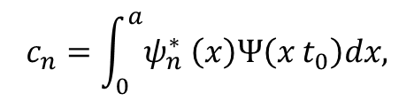

Expanding $\left|S\left(t\right)\right\rangle$ in the momentum basis
How do we prove they are equivalent?
$\left|S\left(t\right)\right\rangle =∫dp (∫dx^{′}\frac{1}{\sqrt{2πℏ}}e^{−i\frac{p}{ℏ}x′}Ψ_{S}\left(x′,t\right)) |p⟩$, so project $⟨x|$ onto both sides, to yield
$⟨x\left|S\left(t\right)\right\rangle =∫dp (∫dx^{′}\frac{1}{\sqrt{2πℏ}}e^{−i\frac{p}{ℏ}x′}Ψ_{S}\left(x′,t\right)) ⟨x|p⟩$, or
$Ψ_{S}\left(x,t\right)=∫dp (∫dx^{′}\frac{1}{\sqrt{2πℏ}}e^{−i\frac{p}{ℏ}x′}Ψ_{S}\left(x′,t\right))\frac{1}{\sqrt{2πℏ}}e^{i\frac{p}{ℏ}x}\text{,}$
$$t)$$
$$c_{n}=\int_{0}^{a}{ψ_{n}^{∗} \left(x\right)Ψ\left(x t_{0}\right)dx,}$$
$$, t$$
0

Slide 16
Take aways?
When actually having to explicitly solve an equation in Dirac notation, you often have to resort to translating it into a differential equation involving wavefunctions, then solve the differential equation.
This “translation” process is facilitated by knowing where and how to insert the unity operator expressed in a well-chosen basis.
Often, but not always, the position basis is chosen to solve the differential equations. (our starting point in this course!)

